Slide 1
D: Various TMB issues
Day 1: 16h00-17h30
Notes:
a

Slide 2
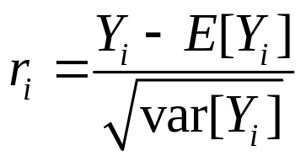
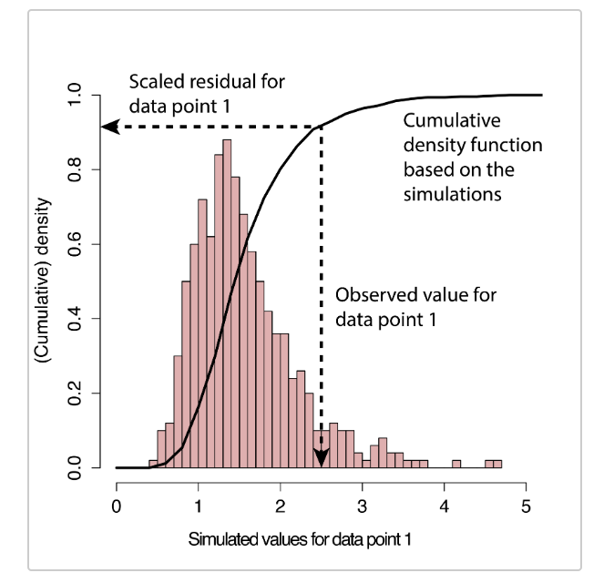
Residual Analysis-I
We can conduct a residual analysis using Pearson residuals, i.e.
Simulation residuals
Simulate data from the model
For each observation, calculate the cdf
Test residual cdf values for uniformity
DHARM package.
Slides based on work by Andrea Havron and Cole Monnahan

Slide 3
Residual Analysis-II
Data <- list(Y=Y, X=X)
Par <- list(Beta=rep(0,2), ln_sd= 0)
compile("test.cpp")
dyn.load("test")
obj <- MakeADFun(Data,Par,DLL="test",silent=T)
opt <- nlminb(obj$par,obj$fn,obj$gr);
print(sdreport(obj))
# simulate data
y.sim <- replicate(500,{obj$simulate()$Y})
n.obs <- length(Y)
sim.resid <- rep(NA, n.obs)
for (i in 1:n.obs) sim.resid[i] <- ecdf(y.sim[i,])(Y[i])
p.val <- ks.test(sim.resid,'punif')$p.value
gap::qqunif(sim.resid,logscale=FALSE)
sim.resid <- createDHARMa(y.sim, Y, integerResponse=F)
plotQQunif(sim.resid)

Slide 4
Random and Fixed Effects-I
Some of the parameters of a model will be hierarchically motivated:
  Random selection of sampling units with a population of such units for a growth study
  Random changes in recruitment success from a distribution of such changes.
Known by other names:
  Random effects (mixed effects) models
  State-space models
  Multi-level models
  Hierarchical models
  Generalized linear (or non-linear) mixed models
  GAMMS

Slide 5
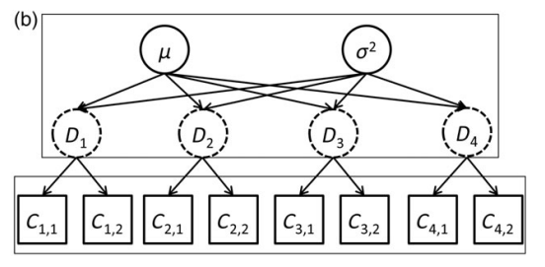
Motivating example
Average density and variability among sites
Density at 4 sites
Observed counts from 2 surveys at each site
The site densities are related (dependent)
The site densities are not directly observed (latent)
Thorson and Minto 2014

Slide 6
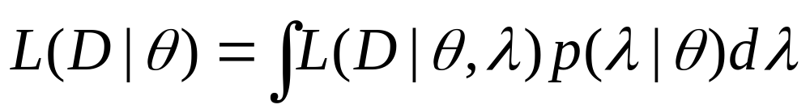
Some Theory
To fit a random (or mixed) effects model, we distinguish the vector of random effects (λ) from the vector of fixed effects (θ). The variance of the random effects is usually one of the fixed effects. The likelihood is the marginal likelihood, i.e.:
where D is the data, θ is the vector of fixed effects, and λ is the vector of random effects.
We use the Laplace approximation to the integral, and select the values for the fixed effects to maximize the (approximated) integral.

Slide 7
Implementation Details
TMB allows some variables (vectors) to be random effects. A variable is treated as a random effect the same way as any other parameter, except:
The variance of the parameter needs to be estimated.
A penalty term needs to be included in the objective function:
for (int y=0;y<(MaxYear-1);y++)
RecPenal -= dnorm(Nrec[y],0,SigmaR,true)
The parameter needs to be declared as random in the MakeAD object:
MakeADFun(data=Data,parameters=Pars, random=c("Nrec"))

Slide 8
MakeADFun-I
(Key Options)
data List containing the data
parameters List containing the parameters
map Used to decide which parameters to estimate
random Which parameters are random?
hessian Calculate the Hessian at the optimum
method Optimization for the outer calculation
DLL What is the DLL name?
control Parameters to control the minimization
(number of function calls, etc)
silent don’t report all sorts of stuff

Slide 9
MakeADFun-I
(outputs)
par, fn, and gr: parameter, likelihood and gradient function.
env: lots of good stuff here
last.par: last parameter vector considered
last.par.best: best parameter vector considered
tracepar:

Slide 10
nlminb
Nlminb allows the user to specify bounds on the parameters and change the controls. Notes:
Use “control=list(eval.max=10000,iter.max=10000)” when things are not converging
Check the convergence output from nlmib (if not 0 you are in trouble)
You can place bounds on the parameters but they are estimated parameters not all parameters (look at model$par see which parameters are “on”)

Slide 11
Phasing
Phasing involves estimating a subset of the parameters then a large subset then.. Unlike ADMB this is not (currently) automatic in TMB. Some hints:
Use the map to specify which parameters to estimate
You need to update the model$par and bounds arguments if you add parameters to be estimated.
I have code to do this (fairly) generically.

Slide 12
Simulation
You can (now) simulate data from anywhere in the cpp code. This changes the data, which can be extracted using the “model$simulate” call from R (lectD1.R)
print(data$y)
simdata <- model$simulate(complete = TRUE)
Thanks to Anders Nielsen for this hint!

Slide 13
Calling cpp functions from R-I
TMB is hard to debug so why not try to call individual functions:
In the cpp file:
#include <TMB.hpp>
template <class Type>
vector<Type> myline(vector<Type> x, Type a, Type b){return a+b*x;}
// R-interface til sub-funktion
extern "C" SEXP call_myline(SEXP x, SEXP a, SEXP b){
vector<double> y = myline(asVector<double>(x), (double)*REAL(a), (double)*REAL(b));
return asSEXP(y);
}

Slide 14
Calling cpp functions from R-II
In R:
## setup call from R
myline<-function(x,a,b).Call("call_myline",as.double(x), as.double(a), as.double(b),PACKAGE="LectD4")
## now you can call
myline(1:10, 1, 1.0001)

Slide 15
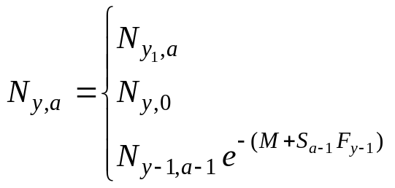
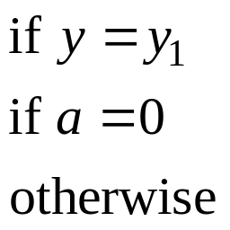
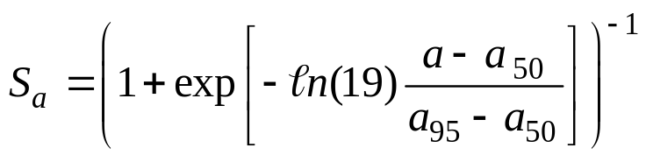
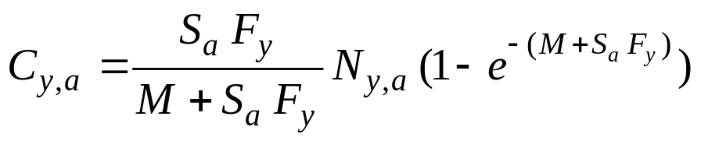
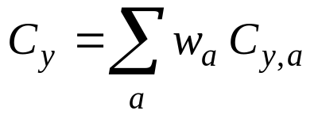
Example-I
(An Age-structured Model)
Fit the following simple age-structured population dynamics
model to CPUE, catch and catch-at-age data.

Slide 16
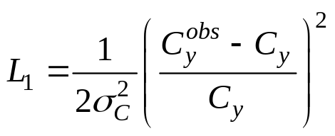
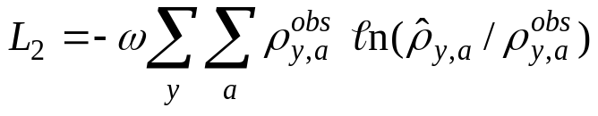
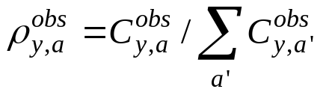
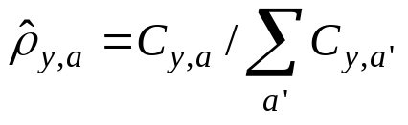
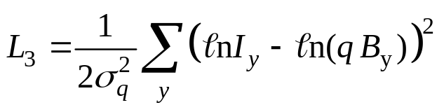
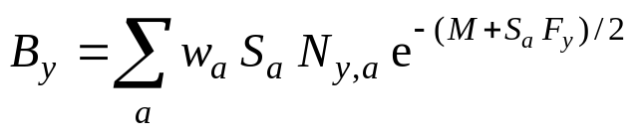
Example-II
(The Likelihood function)
The negative of the logarithm of the likelihood function
includes three contributions: the catch data, the catch-at-age data, and the CPUE data. Likelihoods: normal with constant CV for the first, multinomial for the second, and log-normal for the third.

Slide 17
Example-II
(Parameters and Data)
Numbers in the first year and for age 0 (estimated).
Fully-selected fishing mortality by year (estimated).
Ages-at-50%- and at-95%-selectivity (estimated).
Natural mortality (pre-specified).
Weight-at-age (pre-specified).
Catchability (estimated).
Weights to apply to the catch, CPUE and catch-at-age data (pre-specified).
Catch, CPUE and observed catch proportion-at-age data (pre-specified).

Slide 18
Specifying the data
DATA_INTEGER(Nyear)
DATA_INTEGER(Nage)
DATA_SCALAR(M)
DATA_VECTOR(Wght)
DATA_SCALAR(SigCatch)
DATA_SCALAR(SigCPUE)
DATA_SCALAR(Omega)
DATA_VECTOR(Catch)
DATA_VECTOR(CPUE)
DATA_MATRIX(Propn)
The dimensions of the arrays are determined from R.
SCALAR -> real
If you have variables that are functions of the data, define them in R to save computational demands

Slide 19
Specifying the parameters and derived variables
PARAMETER(dummy);
PARAMETER_VECTOR(LogN);
PARAMETER(Sel50);
PARAMETER(Sel95);
PARAMETER_VECTOR(LogFish);
PARAMETER(logq);
matrix<Type> N(Nyear+1,Nage);
matrix<Type> F(Nyear,Nage);
matrix<Type> Z(Nyear,Nage);
vector<Type> S(Nage);
vector<Type> FullF(Nyear);
Type obj_fun;
The dimensions of the arrays are determined from R.
The names must match those in the parameters argument in R
Temporary variables that are functions of the parameters
This is the function to minimize.

Slide 20
Information to report
REPORT(S);
REPORT(N);
ADREPORT(FullF);
REPORT(CPUEPred);
REPORT(Like1);
REPORT(Like2);
REPORT(Like3);
REPORT(obj_fun);
return(obj_fun);

Slide 21
Tricks in R-I
I write the cpp and R code at the same time (in particular to check the data and parameters are correctly specified).
I define a “dummy*dummy” objective function to keep things simple (and use “map” to make sure the parameters were not being estimated, except dummy).

Slide 22
Tricks in R-II
# test code - for checking for minimization
xx <- model$fn(model$env$last.par)
#cat(model$report()$,"\n")
AAA
# Actual minimzation (with some "Bonus" parameters from nlminb)
fit <- nlminb(model$par, model$fn, model$gr, control=list(eval.max=100000,iter.max=1000))
best <- model$env$last.par.best
rep <- sdreport(model)
print(best)
print(rep)
Code to run the function once

Slide 23
Tricks in R-III
Adding bounds (lectD2.R):
fit <- nlminb(model$par,model$fn,model$gr,lower=c(4,1,-Inf),upper=c(Inf,1.5,Inf))
Phasing (lectD3.R):
Three parameter model
print("Phase 1; No log-Sigma")
map <- list(logSigma=factor(NA))
model <- MakeADFun(data, parameters, DLL="LectB2",map=map,silent=T)
fit <- nlminb(model$par, model$fn, model$gr)
best <- model$env$last.par.best
print(as.numeric(best))
print("Phase 2; All parameters - note I ordered my parameters to make this easier")
Phase2Init <- c(as.numeric(best),0)
model <- MakeADFun(data, parameters, DLL="LectB2",silent=T)
fit <- nlminb(Phase2Init, model$fn, model$gr)

Slide 24

TECHNICAL HELP FROM COLE MONNAHAN

Slide 25
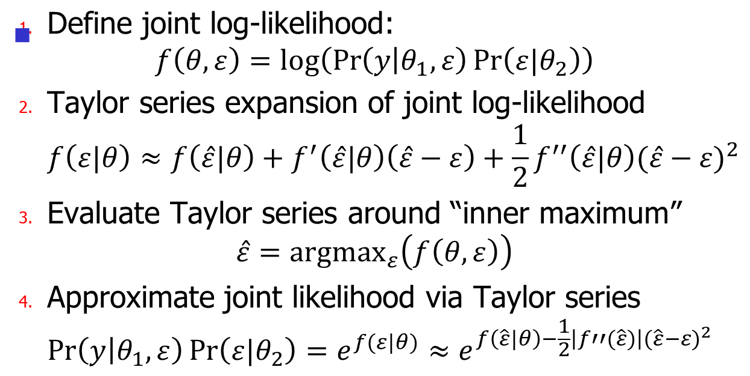
Laplace approximation details I

Slide 26
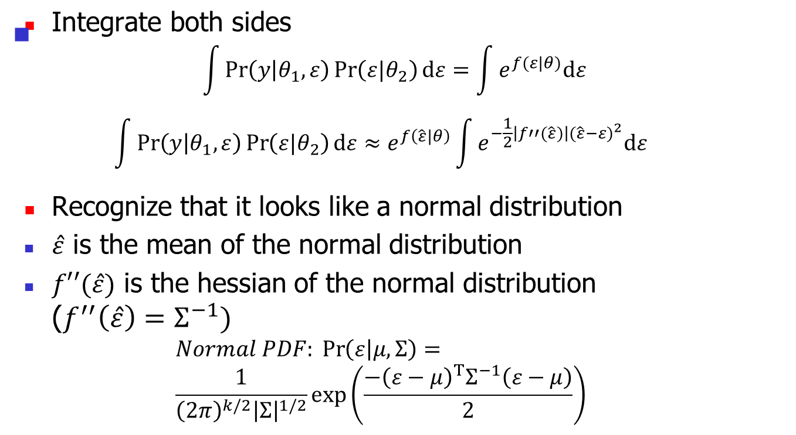
Laplace approximation details II

Slide 27
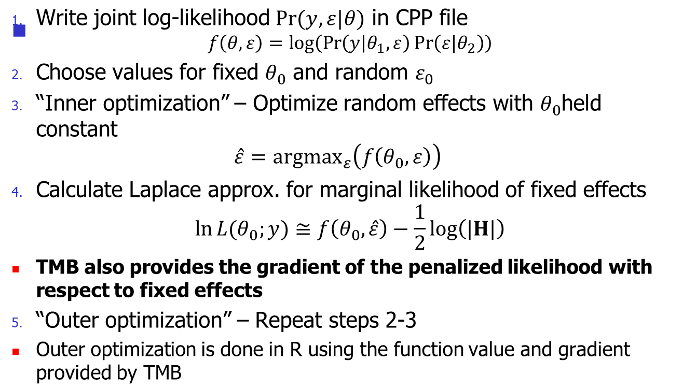
TMB Laplace approximation steps

Slide 28
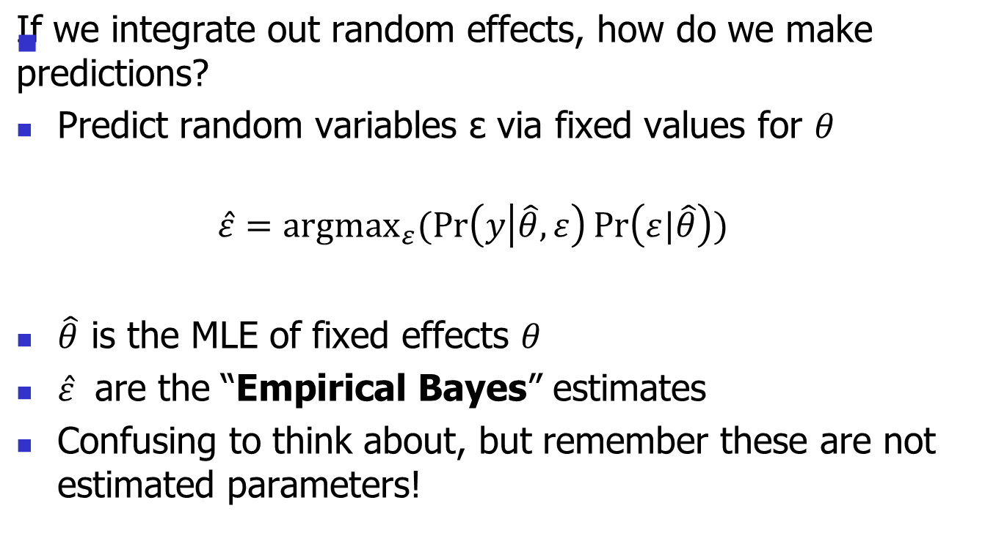
Predicting random variables

